Slide 1


Esteban J. Chinni
February 2023

Slide 2

Outline
Executive Summary
Introduction
Methodology
Results
Conclusion
Appendix

Slide 3
Executive Summary
Summary of methodologies
Data collection, data wrangling, exploratory data analysis (SQL), data visualization (Folium, Plotly) , model development, model evaluation, and reporting
Summary of all results
Predict if the first stage of the SpaceX Falcon 9 rocket will land successfully. All models over predicted successful landings. Additional data is needed to improve model determination and accuracy
Different machine learning models produced: Logistic Regression, Support Vector Machine, Decision Tree Classifier, and K Nearest Neighbors. All produced similar results with accuracy ~ 83.33%.

Slide 4
Introduction
Project background and context
Predict if the Falcon 9 first stage will land successfully. SpaceX advertises Falcon 9 rocket launches on its website, with a cost of 62 million dollars; other providers cost upward of 165 million dollars each, much of the savings is because SpaceX can reuse the first stage. Therefore if we can determine if the first stage will land, we can determine the cost of a launch. This information can be used if an alternate company wants to bid against SpaceX for a rocket launch.
Problems you want to find answers
Which are the variables and their relationship that influence on a successful rocket landing?

Slide 5

Section 1

Slide 6
Methodology
Executive Summary
Data collection methodology:
Retrieved from SpaceX API and web scraped to collect Falcon 9 historical launch records from a Wikipedia page.
Perform data wrangling
Replace missing values with mean and other appropriate methods. Encoding data fields for Machine Learning and dropping irrelevant columns - Classifying true landings as successful and unsuccessful otherwise
Perform exploratory data analysis (EDA) using visualization and SQL
Perform interactive visual analytics using Folium and Plotly Dash
Perform predictive analysis using classification models
Different models were trained. Model with highest accuracy with tuned hyper-parameters was selected.

Slide 7
Data Collection
Describe how data sets were collected
Option 1: Space X API
API
api.spacexdata.com/v4
Jason File
Data Frame
CSV
Option 2: Webscraping
BeautifulSoup
Data Frame
CSV
Tables
Wikipedia
Deal with Nulls values!*
*replace the null values with the mean

Slide 8
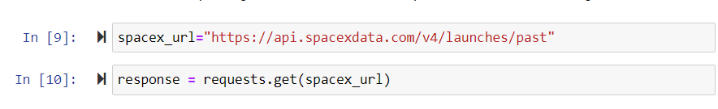
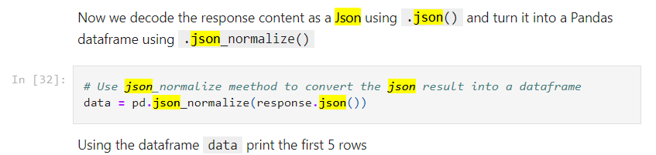
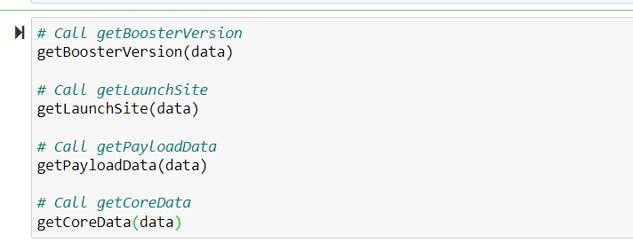
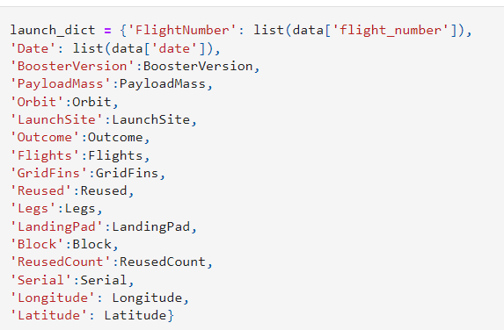
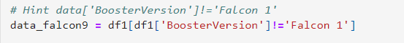

Data Collection – SpaceX API
1
Present your data collection with SpaceX REST calls using key phrases and flowcharts
Getting response from SpaceX-API
Converting response to json-file and transferring into a Data-Frame
Clean up the data using prepared functions
Creating a final dataset with the columns of interest
Filtering dataset for Falcon 9 Launches
Dealing with Missing Values
Export to CSV
2
3
4
5
6
https://github.com/echinni/IBM-Data-Science-Final-Project/blob/299616c7750133b55a37bff9bc523137a74efd3f/Week%201.1%20Data%20Collection%20API%20Lab.ipynb
7

Slide 9
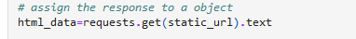
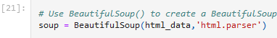
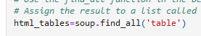
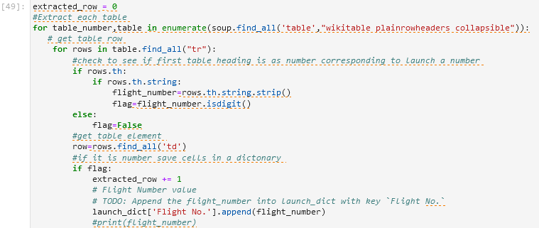
Data Collection - Scraping
Present your web scraping process using key phrases and flowcharts
Request the Falcon9 Launch Wiki page from its URL
Create Beautiful-soup object from HTML response
Extract all column/variable names from the HTML table header
Create a data frame by parsing the launch HTML tables
Exporting data to CSV-file
1.
2.
3.
4.
https://github.com/echinni/IBM-Data-Science-Final-Project/blob/27f6af94f87a0723c6205f574710349e367e0a51/Week%201.2%20Data%20Collection%20with%20Web%20Scraping.ipynb
5.
9

Slide 10
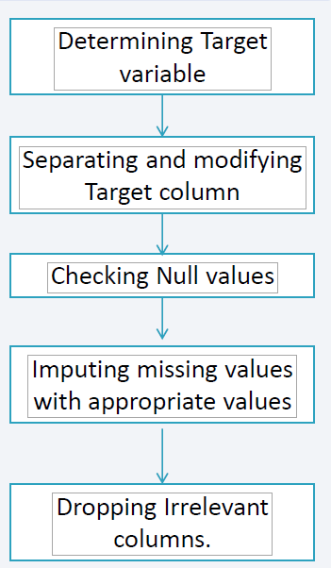
Data Wrangling
Perform some Exploratory Data Analysis (EDA) to find some patterns in the data and determine what would be the label for training supervised models.
Identify and calculate the percentage of the missing values in each attribute
Calculate the number of launches on each site
Calculate the number and occurrence of each orbit
Calculate the number and occurence of mission outcome per orbit type
Create a landing outcome label from Outcome column: 1 means the booster successfully landed 0 means it was unsuccessful.
https://github.com/echinni/IBM-Data-Science-Final-Project/blob/c2bec7687974aa338e71b890a31787c1f98ef875/Week%201.3%20Data%20Wrangling.ipynb

Slide 11
EDA with Data Visualization
Summarize what charts were plotted and why you used those charts
Scatterplots are useful to show relationships between variables
Bar charts are suitable for comparing the ratio of a variable in discrete classes with one another, if necessary, grouping them as well
Line plots show the progression of variables over time
Flight Number vs. Payload Mass
Flight Number vs. Launch Site
Payload Mass vs. Launch Site
Orbit vs. Success Rate
Flight Number vs. Orbit
Payload vs Orbit
Success Yearly Trend
IBM-Data-Science-Final-Project/Week 2.2 EDA with Visualization Lab.ipynb at main · echinni/IBM-Data-Science-Final-Project (github.com)

Slide 12
EDA with SQL
Using bullet point format, summarize the SQL queries you performed
Loaded data set into IBM DB2 Database.
Queried using SQL Python integration.
Queries were made to get a better understanding of the dataset.
Queried information about launch site names, mission outcomes, various pay load sizes of customers and booster versions, and landing outcomes
IBM-Data-Science-Final-Project/Week 2.1 Complete the EDA with SQL lab2.ipynb at main · echinni/IBM-Data-Science-Final-Project (github.com)

Slide 13
Build an Interactive Map with Folium
Summarize what map objects such as markers, circles, lines, etc. you created and added to a folium map. Explain why you added those objects
Folium maps mark Launch Sites. Given a text label, and its latitude and longitude, successful (green) and unsuccessful (red) landings, and a proximity example to key locations: Railway, Highway, Coast, and City.
This allows us to understand why launch sites may be located where they are. Also visualizes successful landings relative to location.
IBM-Data-Science-Final-Project/Week 3.1 Data Visualization with Folium.ipynb at main · echinni/IBM-Data-Science-Final-Project (github.com)

Slide 14
Build a Dashboard with Plotly Dash
Pie Chart showing the total launches by a certain site/all sites
display relative proportions of multiple classes of data.
size of the circle can be made proportional to the total quantity it represents.
Scatter Graph showing the relationship with Outcome and Payload Mass (Kg) for the different Booster Versions
It shows the relationship between two variables.
It is the best method to show you a non-linear pattern.
The range of data flow, i.e. maximum and minimum value, can be determined.
Observation and reading are straightforward.
https://cf-courses-data.s3.us.cloud-object-storage.appdomain.cloud/IBM-DS0321EN-SkillsNetwork/labs/module_3/lab_theia_plotly_dash.md.html

Slide 15
Predictive Analysis (Classification)
Summarize how you built, evaluated, improved, and found the best performing classification model
You need present your model development process using key phrases and flowchart
Add the GitHub URL of your completed predictive analysis lab, as an external reference and peer-review purpose

Slide 16
Predictive Analysis (Classification)
Import Libraries and Define Auxiliary Functions
Load the dataframe
Create a NumPy array
Standardize the data
Split the data X and Y into training and test data.
Create a LOGISTIC REGRESSION object and create a GridSearchCV
Calculate the accuracy on the test data using the method score and graph confusion matrix
Create a SUPPORT VECTOR MACHINE and fit object to find the best parameters
Calculate the accuracy on the test data using the method score. Graph confusion matrix
Create a DECISION TREE CLASSIFIER object and fit object to find the best parameters
Create a K NEAREST NEIGHBORS object. Fit the object to find the best parameters
Calculate the accuracy of tree_cv on the test data using the method score. Graph confusion Matrix.
Calculate the accuracy of knn_cv on the test data using the method :
Find the method performs best. Graph bar chart
Best Algorithm is DECISION TREE CLASSIFIER (score of 0.875)
IBM-Data-Science-Final-Project/Week 4 Machine Learning Prediction.ipynb at main · echinni/IBM-Data-Science-Final-Project (github.com)

Slide 17
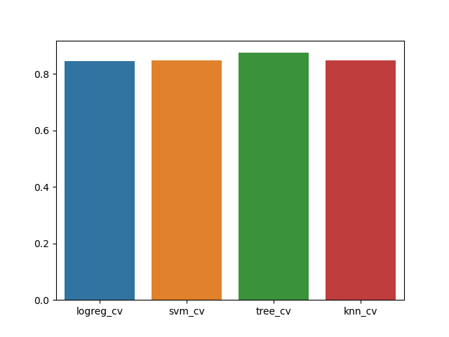
Results
Exploratory data analysis results
Interactive analytics demo in screenshots
Predictive analysis results

Slide 18

Section 2

Slide 19
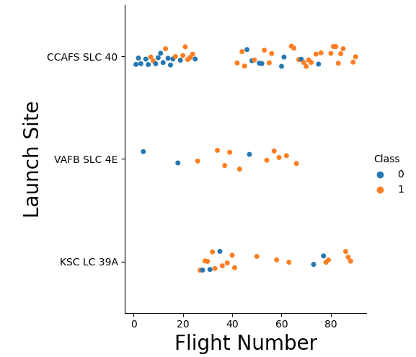
Flight Number vs. Launch Site
Launch success rate increased over the time (from 0% to 100%)
Most part of the launches were performed from CCAFS
VAFB SLC 4E and KSC LC 39A have the highest success rates for starting positions.

Slide 20
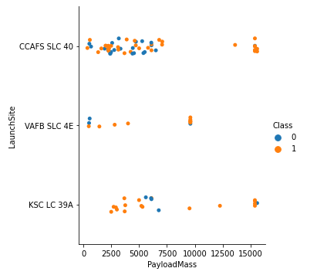
Payload vs. Launch Site
The larger the payload, the better the success rate, except for KSC.
The VAFB SLC 4E launch site appears inadequate for launches with heavy payloads (>10.000)

Slide 21
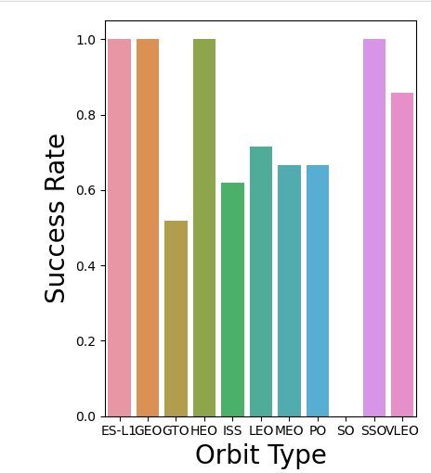
Success Rate vs. Orbit Type
•The orbits ES-L1, GEO, HEO and SSO have highest 100% sucess rate.
•No successful launch found fororbit type SO.
•The rest of orbit types present a success rate of around 60%.

Slide 22
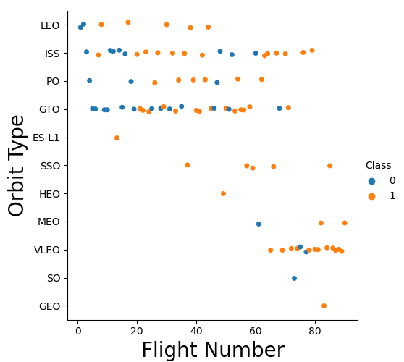
Flight Number vs. Orbit Type
VLEO orbit was selected for the most recent launches (from flight 65 on). Present a high successful rate of 86%.
Higher number of launches: ISS (21), GTO (27) and VLEO (14).
No relationship between orbit type and flight number for GTO and ISS orbits
SpaceX appears to perform better in lower orbits or Sun-synchronous orbits

Slide 23
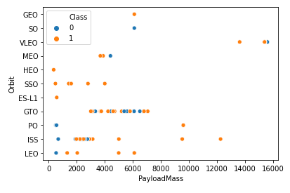
Payload vs. Orbit Type
Low payloads and low orbits indicate a low success rate, but this could also have been the result of the early launch attempts.
Higher launches: orbits GTO and ISS.
ISS have the most diverse array of payloads

Slide 24
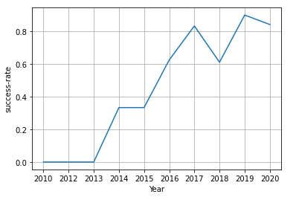
Launch Success Yearly Trend
Success generally increases over time since 2013 with a slight dip in 2018
Success in recent years at around 80%

Slide 25
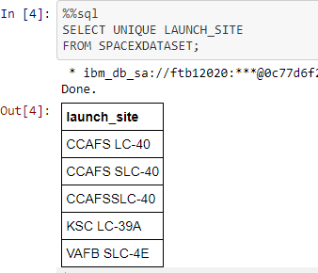
All Launch Site Names
Query unique launch site names from database.
CCAFS SLC-40 and CCAFSSLC-40 likely all represent the same
launch site with data entry errors.
CCAFS LC-40 was the previous name. Likely only 3 unique launch_site values: CCAFS SLC-40, KSC LC-39A, VAFB SLC-4E

Slide 26
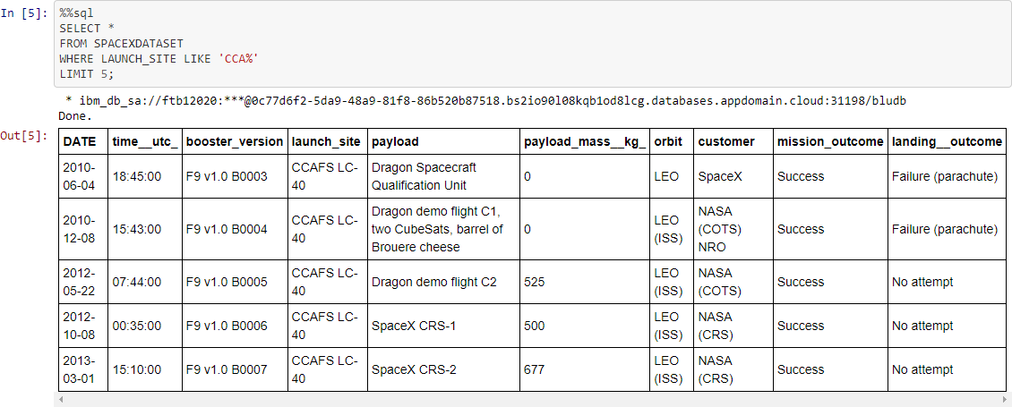
Launch Site Names Begin with 'CCA'
Find 5 records where launch sites begin with `CCA`
First five entries in database with Launch Site name beginning with CCA.

Slide 27
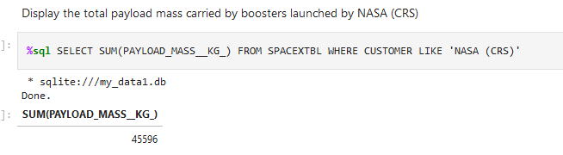
Total Payload Mass
Calculate the total payload carried by boosters from NASA
The result returns the total payload of all boosters launched by NASA.

Slide 28
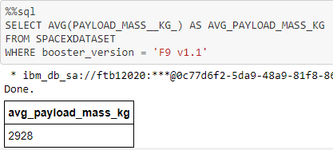
Average Payload Mass by F9 v1.1
This query calculates the average payload mass or launches which used booster version F9 v1.1
Average payload mass of F9 1.1 is on the low end of our payload mass range

Slide 29
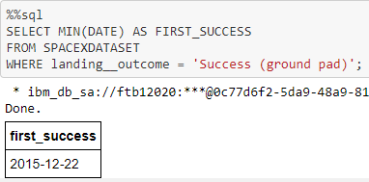
First Successful Ground Landing Date
This query returns the first successful ground pad landing date.
First ground pad landing wasn’t
until the end of 2015.
Successful landings in general
appear starting 2014.

Slide 30
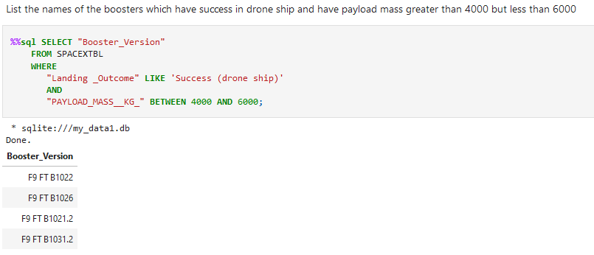
Successful Drone Ship Landing with Payload between 4000 and 6000
Result lists the names of boosters which have successfully landed on drone ship and had payload mass greater than 4000 but less than 6000

Slide 31
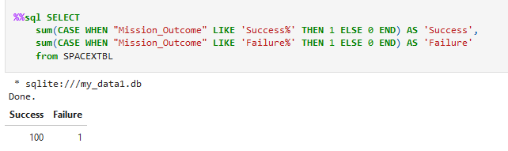
Total Number of Successful and Failure Mission Outcomes
Results display the total number of successful and failed mission outcomes. It states that the failed are minimal.

Slide 32
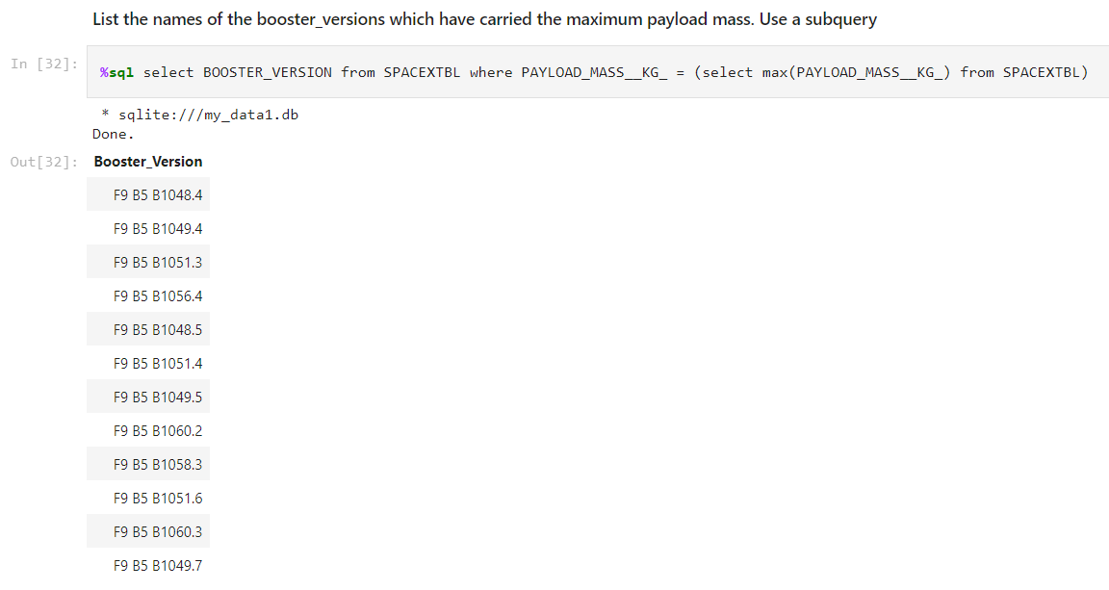
Boosters Carried Maximum Payload
List the names of the booster which have carried the maximum payload mass
Query returns the names of the booster versions that carried the maximum payload, a total of 12 booster versions

Slide 33
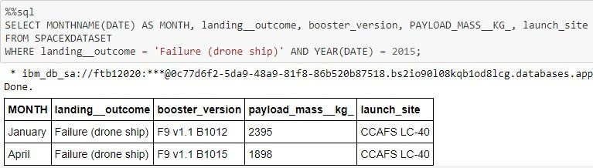
2015 Launch Records
List the failed landing_outcomes in drone ship, their booster versions, and launch site names for in year 2015
This query returns the Month, Landing Outcome, Booster Version, Payload Mass (kg), and Launch site of 2015 launches where stage 1 failed to land on a drone ship.
There were two such occurrences.

Slide 34
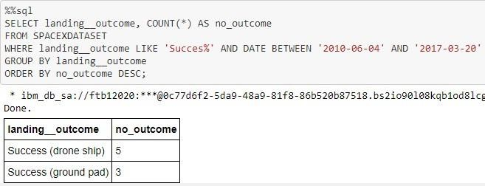
Rank Landing Outcomes Between 2010-06-04 and 2017-03-20
Rank the count of landing outcomes (such as Failure (drone ship) or Success (ground pad)) between the date 2010-06-04 and 2017-03-20, in descending order
This query returns a list of successful landings and between 2010-06-04 and 2017-03-20 inclusively.
There are two types of successful landing outcomes: drone ship and ground pad landings.
There were 8 successful landings in total during this time period

Slide 35

Section 3

Slide 36
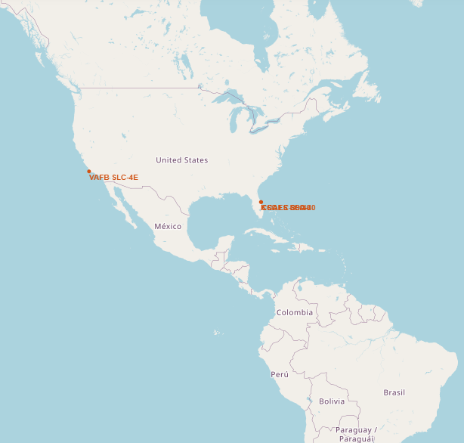
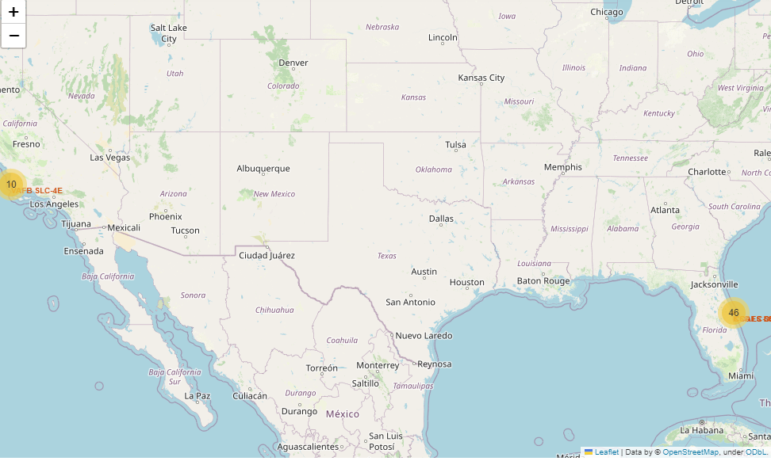
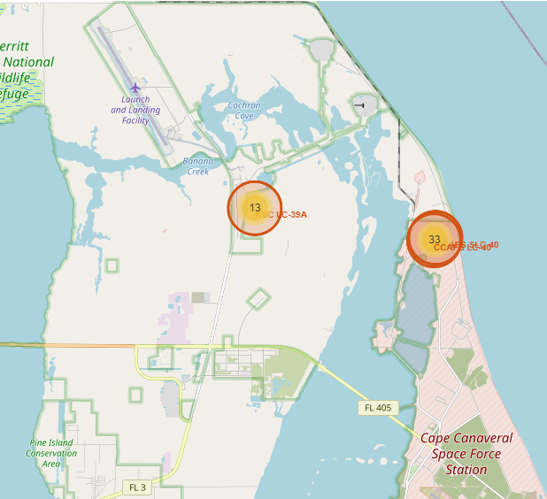
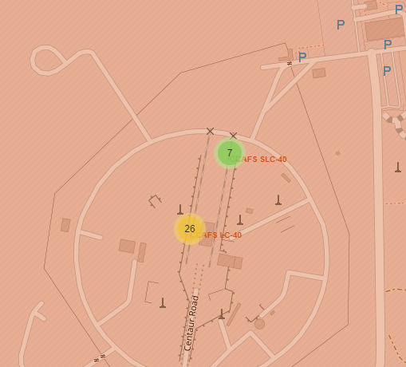
Space X Launch Sites
- Three launch sites are close to each other in Orlando, Florida.
- One launch site is in California.
- All launch sites are close to the coast so that first stage can be thrown to the sea after the take-off.

Slide 37
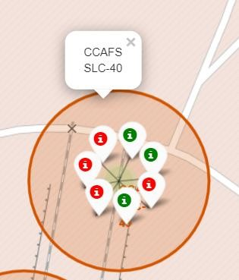
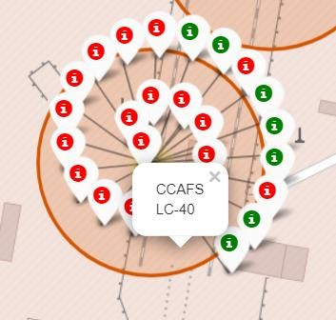
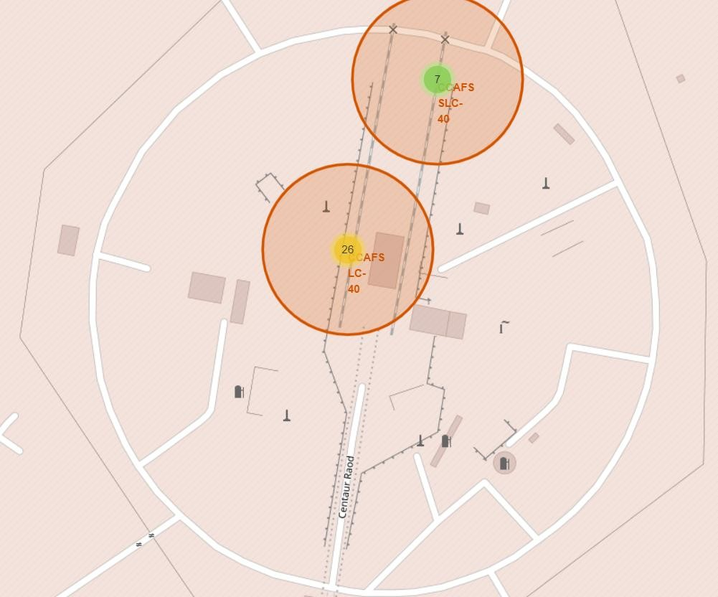
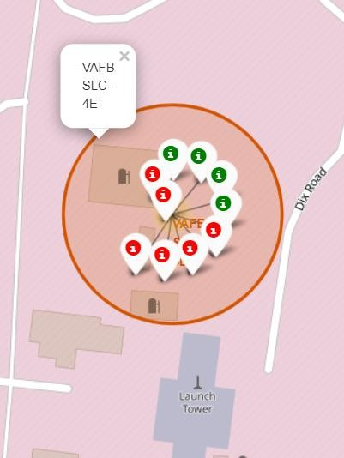
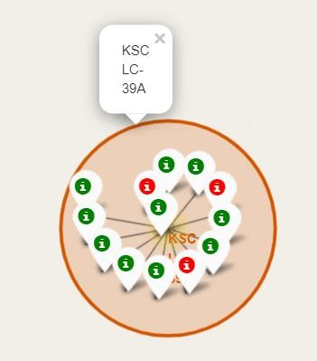
Success Launches
CALIFORNIA
FLORIDA
Green Marker shows successful Launches and Red Marker shows Failures

Slide 38



Strategic Location
Close to railways for large part and supply transportation
Close to highways for human and supply transport
Close to coasts and relatively far from cities so that launch failures can land in the sea and avoiding rockets falling populated areas.

Slide 39

Section 4

Slide 40


Launch success count for all sites
Most successful launch attempts: "KSC LC-39A“
2/3 of the total successful missions: "KSC LC-39A" and "CCAFS LC-40“
VAFB has the smallest share of successful landings. This may be due to smaller sample and increase in difficulty of launching in the west coast..

Slide 41
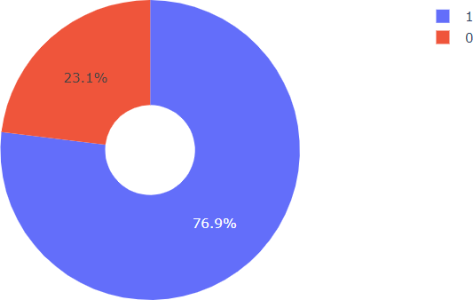
Launch site with highest launch success ratio
KSC LC-39A has the highest success rate with 10 successful landings and 3 failed landings.

Slide 42
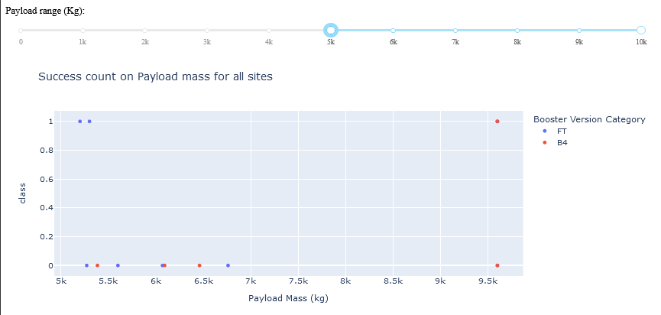
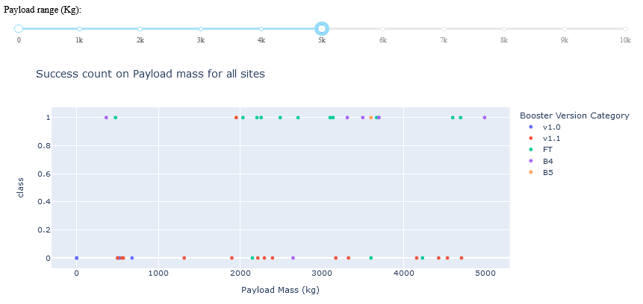
Payload vs. Launch Outcome
Plotly dashboard has a Payload range selector.
Class indicates 1 for successful landing and 0 for failure.
Scatter plot also accounts for booster version category in color and number of launches in point size.
We can see the success rates for low weighted payloads is higher than the heavy weighted payloads

Slide 43

Section 5

Slide 44
Classification Accuracy
After selecting the best hyperparameters for the decision tree classifier using the validation data, we achieved 83.33% accuracy on the test data.
Decision Tress has the highest classification accuracy

Slide 45

Confusion Matrix
The major problem is false positives.

Slide 46
Conclusions
It is observed that Decision tree has the highest classification accuracy with accuracy score of 88.8%.
Low weighted payloads perform better than the heavier payloads
The success rates for SpaceX launches is directly proportional time in years they will eventually perfect the launches
We can see that KSC LC-39A had the most successful launches from all the sites
Orbit GEO,HEO,SSO,ES-L1 has the best Success Rate
Launch sitres are located close to coast, eailways and highways mainting safety distance from cities
Allon Mask of SpaceY can use this model to predict with relatively high accuracy whether a launch will have a successful Stage 1 landing before launch to determine whether the launch should be made or not

Slide 47
Appendix
Github url for Capstone Project
Thank you for taking time and evaluate the project!
echinni/IBM-Data-Science-Final-Project: Python Basics for Data Science Project (github.com)

Slide 48


